Slide 1


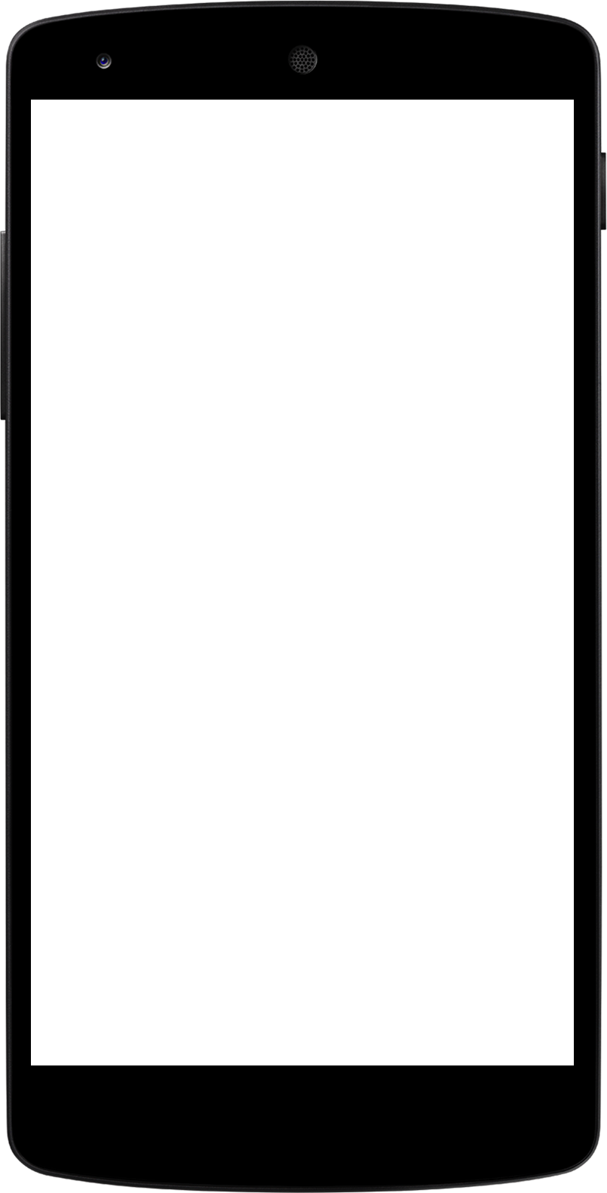
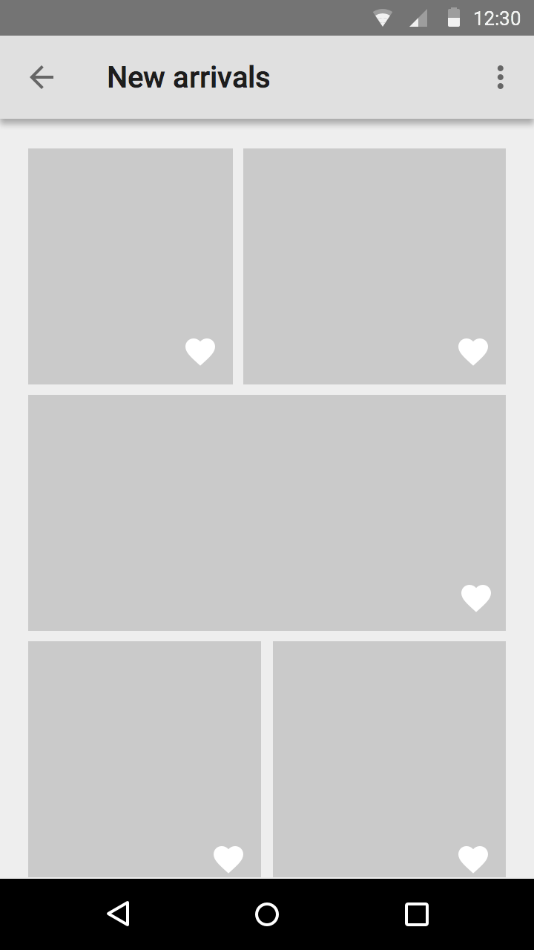

Demo Project
HTML , CSS , Bootstrap , Javascript , Ajax
Lavanya Seetharaman
Instructor@BoardInfinity

Slide 2


Slide 3
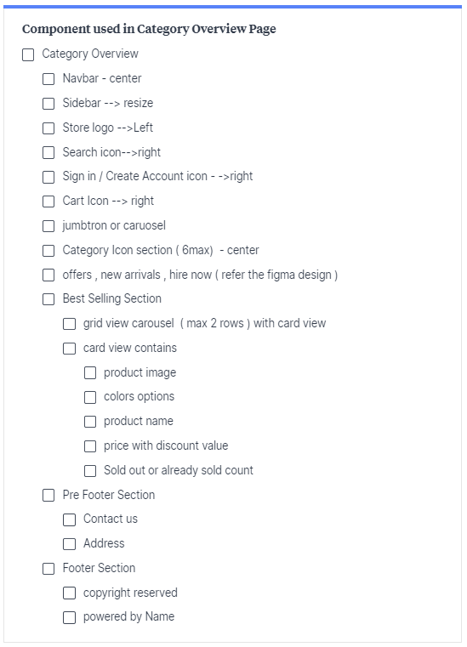
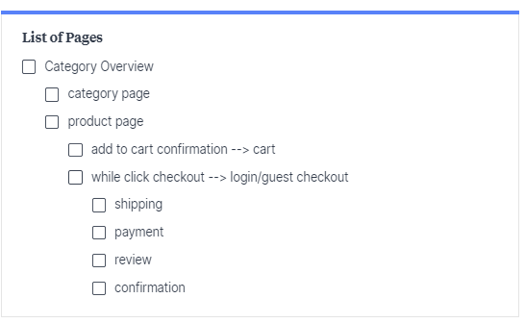
Start with wireframe / sketch / design flow
https://milanote.com/
https://www.figma.com/
https://www.sketch.com/
Notes:
https://archive.barrelny.com/blog/25-must-have-pages-for-your-e-commerce-website/

Slide 4
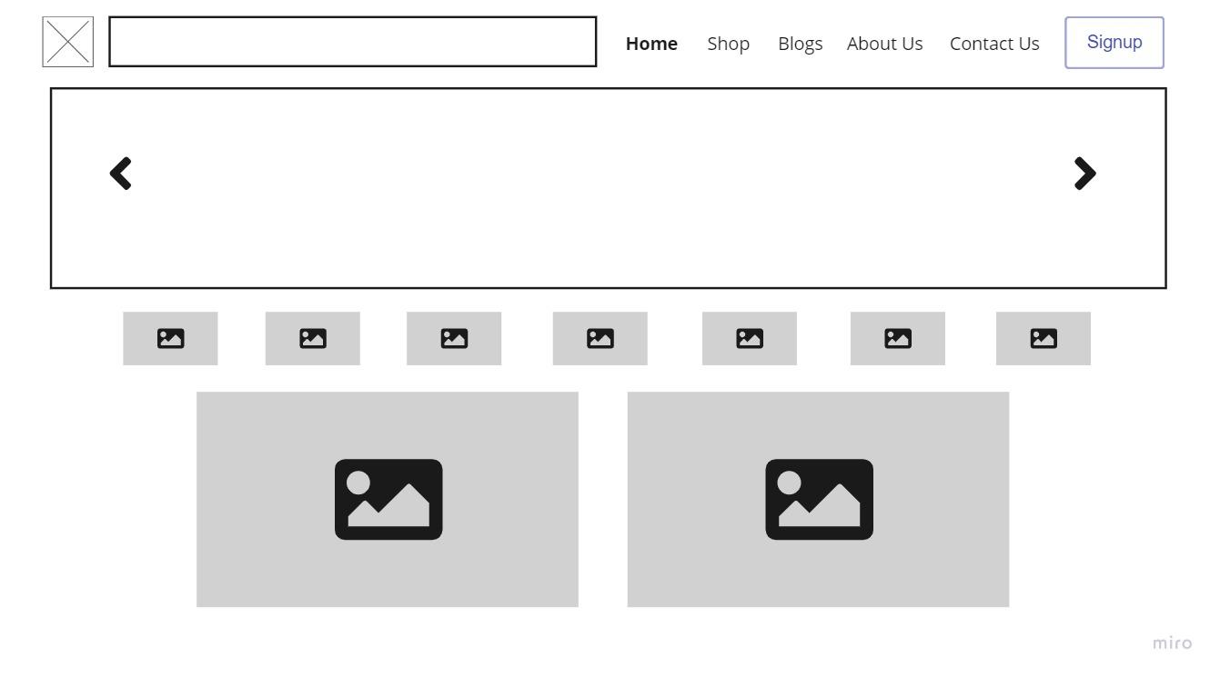
Start with wireframe / sketch / design flow
https://miro.com/
Notes:
https://archive.barrelny.com/blog/25-must-have-pages-for-your-e-commerce-website/
https://medium.com/inspiration-supply/wireframes-by-top-ux-designers-d6922d34ddb8

Slide 5
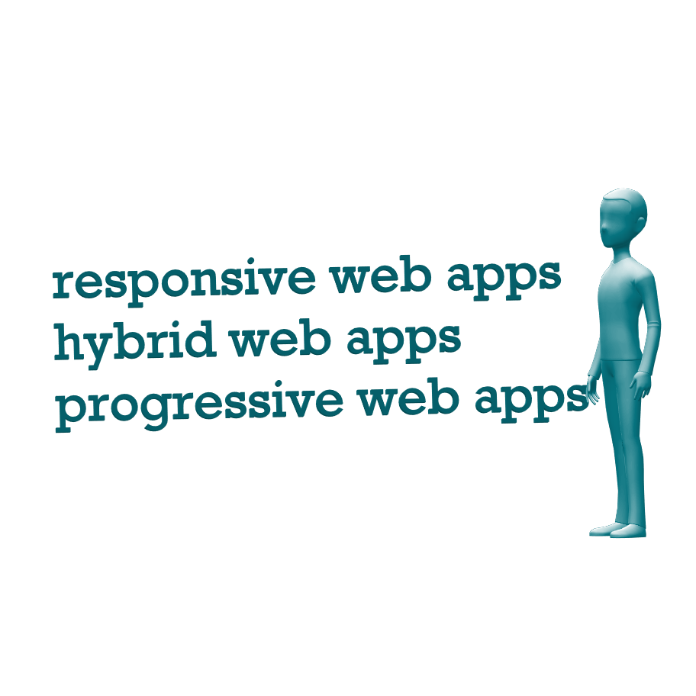

Pick your target devices

Slide 6
Pick your framework or library
Abstract vector created by vectorjuice - www.freepik.com

